Slide 1
Lab work-4
Name of the experiment: RSA key encryption and perform Spoofing.
Dr. Abdullah-Al-Musa
(B.Sc(Hons) In Computing, M.Engg In Information System Security , PhD)
Department of Computer Science & Engineering
Bangladesh University of Business and Technology (BUBT)

Slide 2

Legal Disclaimer
In addition, this is teaching purpose the Lab exercise and this does not condone malicious behavior of any kind inside the Lab.
You are on notice, that continuing and/or using this lab outside is your "own responsibility“ and test environment is considered malicious and is against the law such as Bangladesh Digital Security Act 2018 , Bangladesh Information and Communication Technology Act 2006 .
Dr.Abdullah© 2021 -- no content should be replicated and it is not allowed without express written permission.

Slide 3
Introduction:
RSA (Rivest–Shamir–Adleman) is a public-key cryptosystem that is widely used for secure data transmission. In a public-key cryptosystem, the encryption key is public and distinct from the decryption key, which is kept secret (private). An RSA user creates and publishes a public key based on two large prime numbers, along with an auxiliary value. The prime numbers are kept secret. Messages can be encrypted by anyone, via the public key, but can only be decoded by someone who knows the prime numbers.

Slide 4
The security of RSA relies on the practical difficulty of factoring the product of two large prime numbers, the "factoring problem". Breaking RSA encryption is known as the RSA problem. Whether it is as difficult as the factoring problem is an open question. There are no published methods to defeat the system if a large enough key is used.

Slide 5
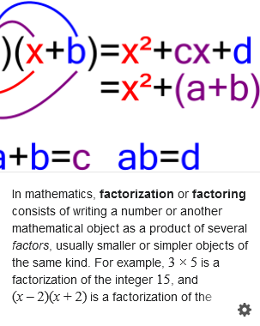
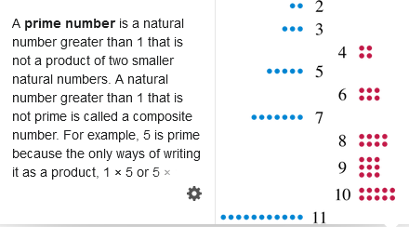

Slide 6
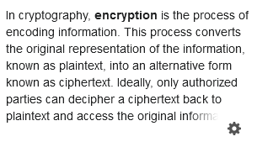
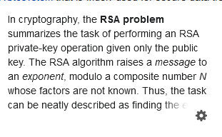

Slide 7
Basically we use private key for encryption and public key for decryption .
So the first step is to generate a public key.

Slide 8
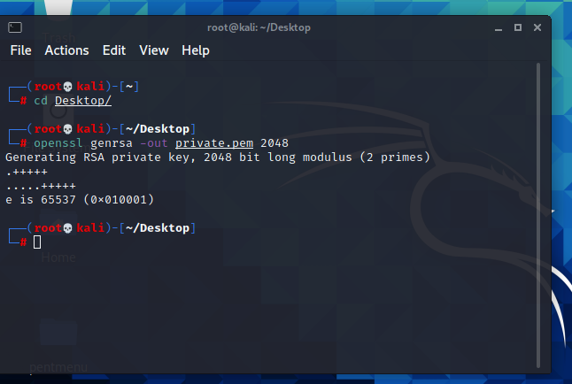

Slide 9
We can see private .pem file is generated in desktop

Slide 10
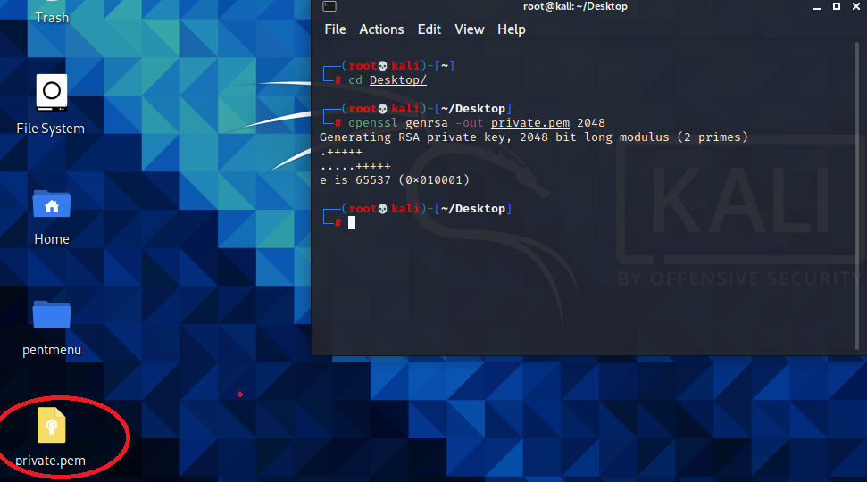

Slide 11
Let’s open the private key.

Slide 13
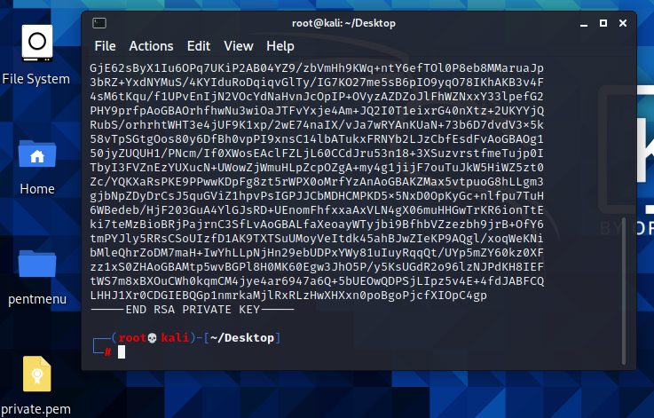

Slide 14
Now generate a public key.

Slide 15
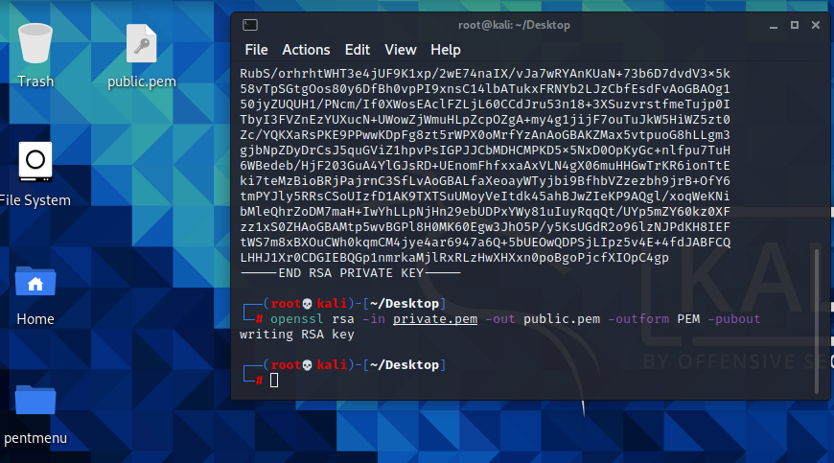

Slide 16
We can see another file is create in the desktop public.pem

Slide 17
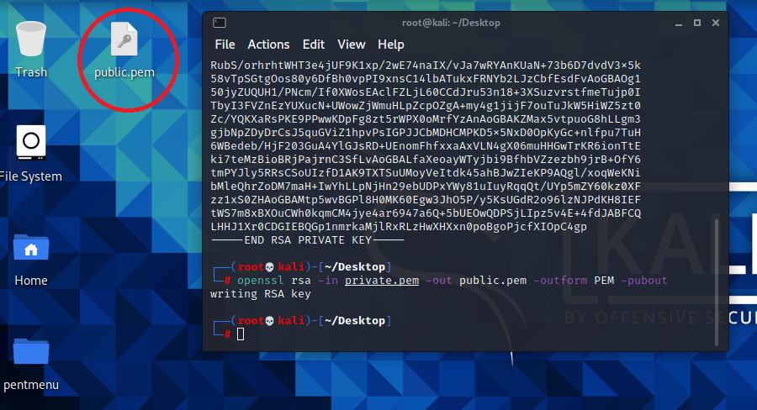

Slide 18
Let’s open it.

Slide 19
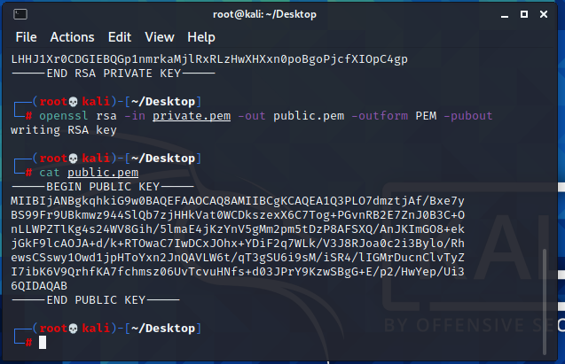

Slide 20
We’ll see , randomly a lot of public key .
Now , we have already created two key . So , now we want to encrypt and decrypt file.
So , this is we called asymmetric encryption.
Let’s make a text file , let’s say it , mydata.txt , and see what is inside that file.

Slide 21
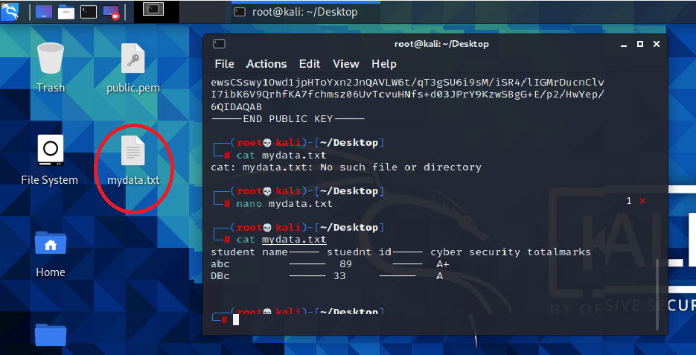

Slide 22
Now , let’s encrypt the mydata.txt file.

Slide 23
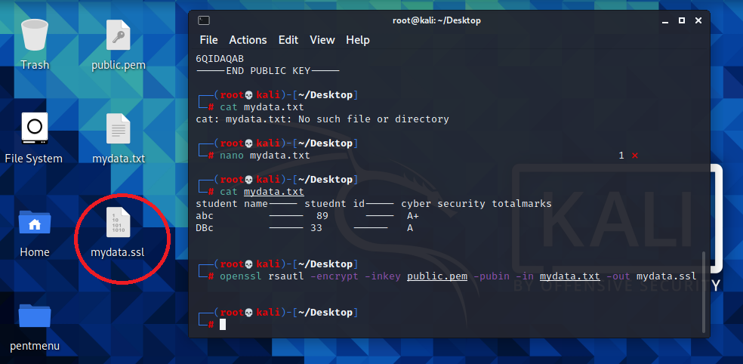

Slide 24
As you can see , on desktop , a file mydata.ssl.
This is actually an unreadable file. Let’s open it .

Slide 25
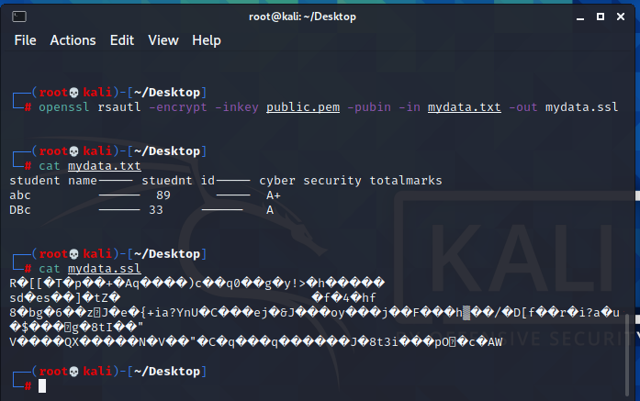

Slide 26
Now decrypt the file.

Slide 27
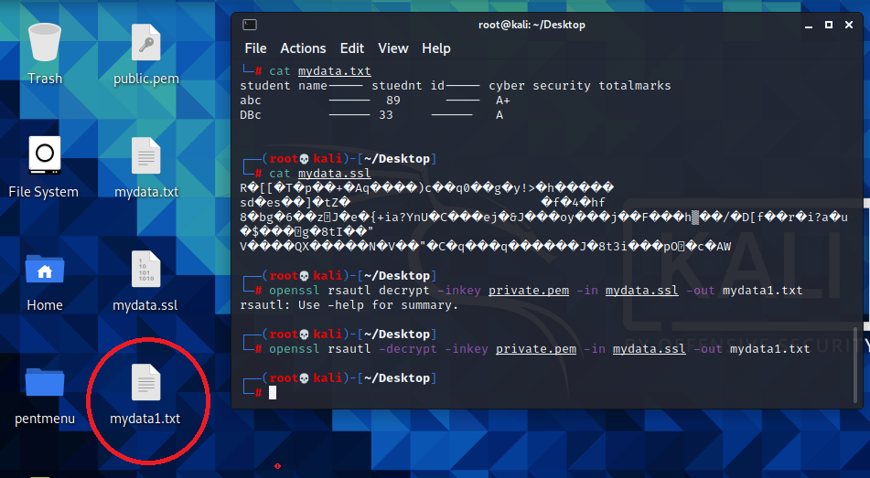

Slide 28
Must give a different name of new text file. Let’s see what data inside.

Slide 29
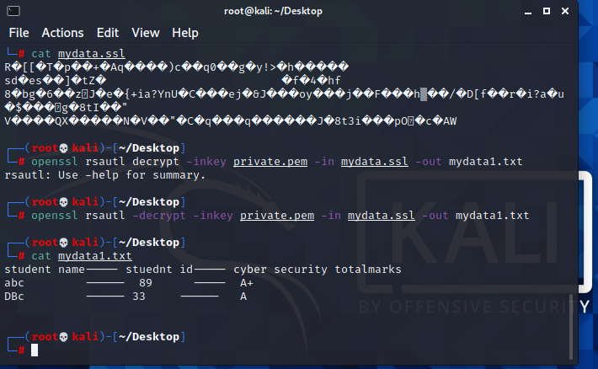

Slide 30
Advanced Encryption Standard (AES)
Encryption is one of the most common ways to protect sensitive data. Encryption works by taking plain text and converting it into cipher text, which is made up of seemingly random characters. Only those who have the special key can decrypt it. AES uses symmetric key encryption, which involves the use of only one secret key to cipher and decipher information.

Slide 31
The Advanced Encryption Standard (AES) is the first and only publicly accessible cipher approved by the US National Security Agency (NSA) for protecting top secret information. AES was first called Rijndael after its two developers, Belgian cryptographers Vincent Rijmen and Joan Daemen.
The following illustration shows how symmetric key encryption works:

Slide 32
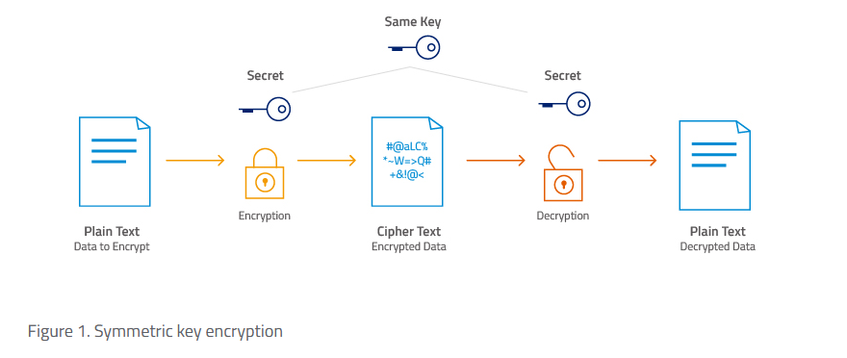

Slide 33
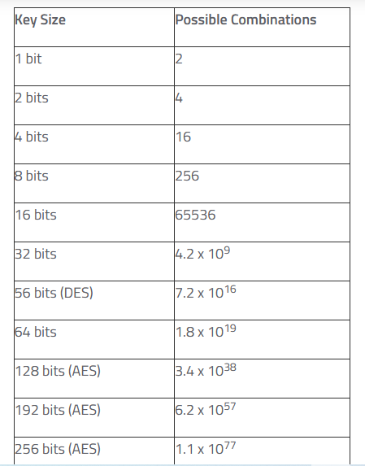

Slide 34
Let’s encrypt a file , such as mydata.txt by ASE-256 key.

Slide 35
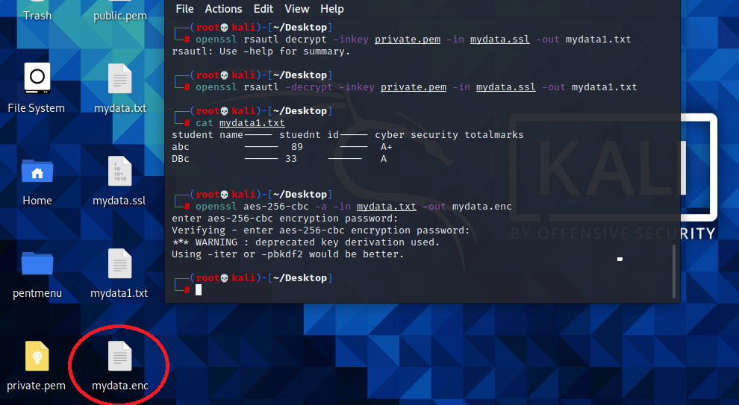

Slide 36
Let’s see what is inside of that file.

Slide 37
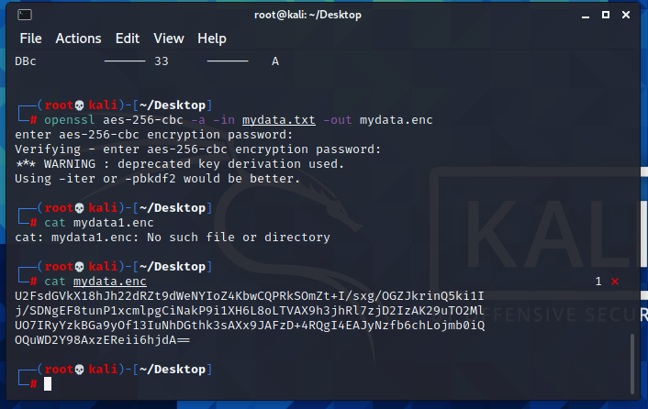

Slide 38
Let’s decrypt the file.

Slide 39
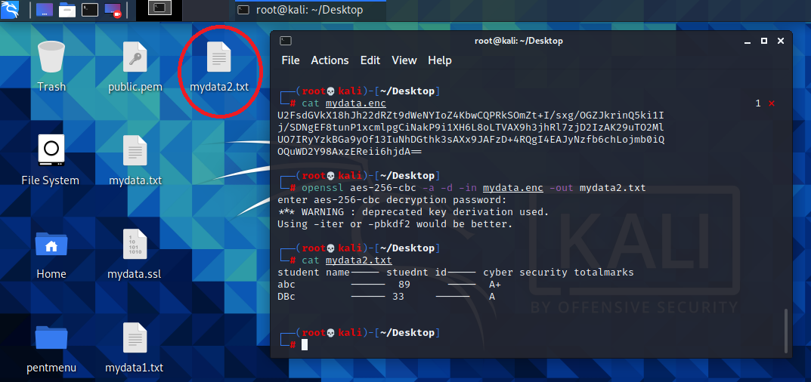

Slide 40
Q AND A

